Slide 1

AR BASED MOBILE APPILCATION
MANOJ R.D
124006059
EIE / SEEE
HARI HARAN M.V
124006058
EIE / SEEE
Dr. GHOUSIYA BEGUM K
Asst. Professor
EIE / SEEE
SASTRA Deemed University

Slide 2
Presentation Outline
Abstract
Block Diagram
Software used
Timeline Activity
Hardware
Output
Navigation part
Reference

Slide 3
ABSTRACT:
This project focuses on developing a mobile augmented reality (AR) application that integrates computer vision(CV) technology and can also control things in the Internet of Things (IoT). The goal of the project is to enhance the user's AR experience by providing advanced image & object recognition and classification capabilities. The application uses the camera on the mobile device to capture images of real-world objects and uses CV algorithms to identify the location and classify the objects in real-time. Also, this application can control things virtually.
Overall, this project demonstrates the potential of integrating CV technology and IoT into AR applications to create new and exciting user experiences .

Slide 4
BLOCK DIAGRAM:
BLYNK CLOUD
FRONT-END
USER INTERFACE
UI DESIGNING
ANIMATION
C# SCRIPTING FOR CANVAS
VIRTUAL BUTTON
TEMPERATURE CONTROL SYSTEM.
--which is able to maintain the threshold temperature given by user.
--some of the home appliances like leds , servo angle.
BACK-END
VIRTUAL BUTTON TO UPDATE THE VALUE
TRIGGERING THE CLOUD BY API
UNIFIED REFRENCE TO AVOID DUBLICATE
UNIFIED REFERENCE
WIRELESS

Slide 5
SOFTWARE USED:
Unity :
To create the frontend work like UI and Scripting(C#)
Vuforia :
Vuforia supports many third-party devices (such as AR/MR glasses), and VR devices with back-facing cameras A component which creates an image of a particular viewpoint in your scene.
Visual studio :
For doing all the script works.
Arway:
To navigate we use CV based area recognition for indoor navigation, location(GPS) based outdoor campus navigation.

Slide 6
TIMELINE ACTIVITY:
Designing an application with could control things.
Code an Script for UI objects and virtual button.
Design an IOT based auto machine.
Reading sensor data with real time ,with virtual button.
Controlling things with virtual button, and with UI button .
Design an outdoor navigation(campus tour)
Designing an AR indoor and campus navigation , with the help of CV , cloud based navigation.
Outdoor navigation with help of the GPS in device.

Slide 7
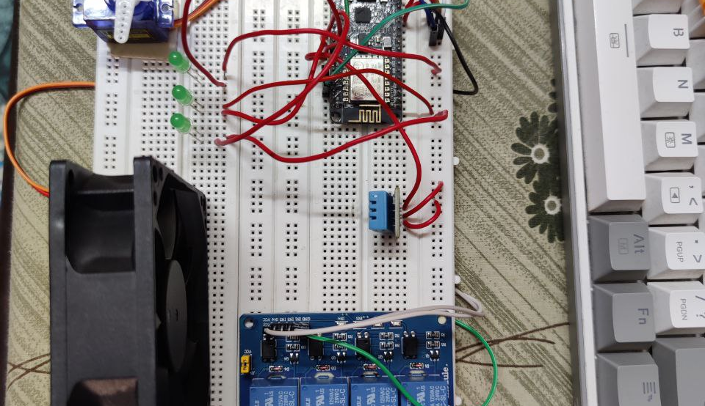
HARDWARE:

Slide 8
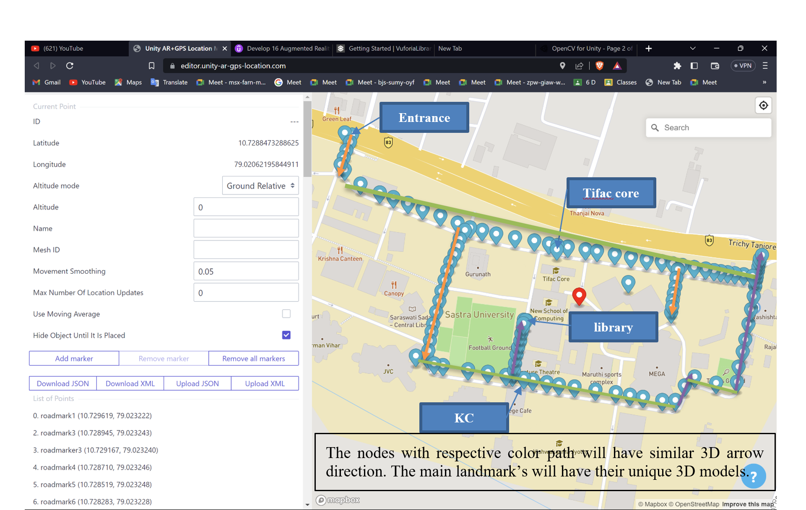
AR NAVIGATION

Slide 9
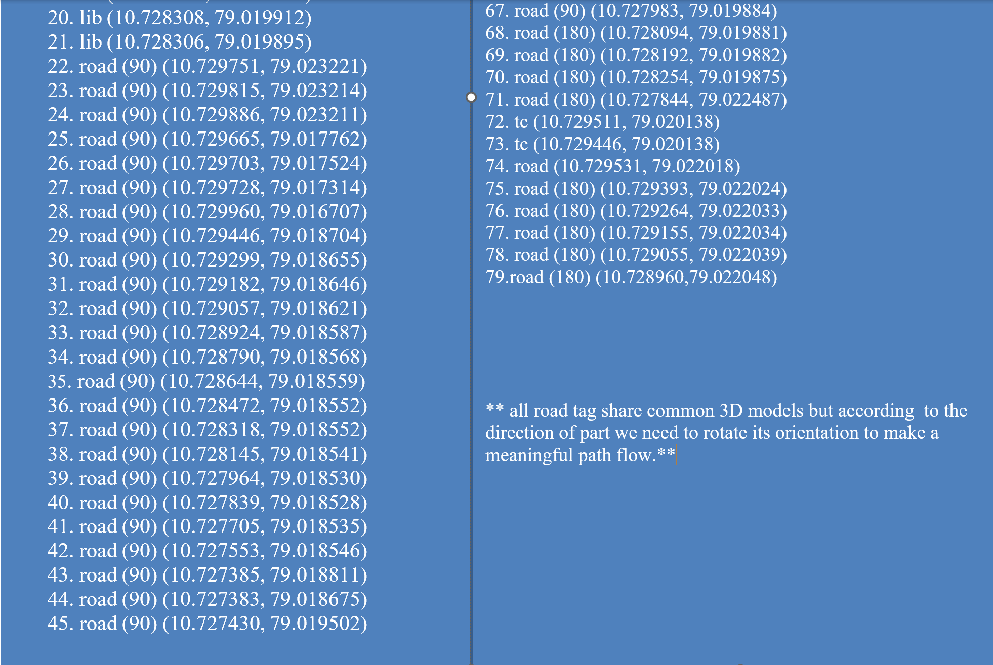
AR NAVIGATION

Slide 10
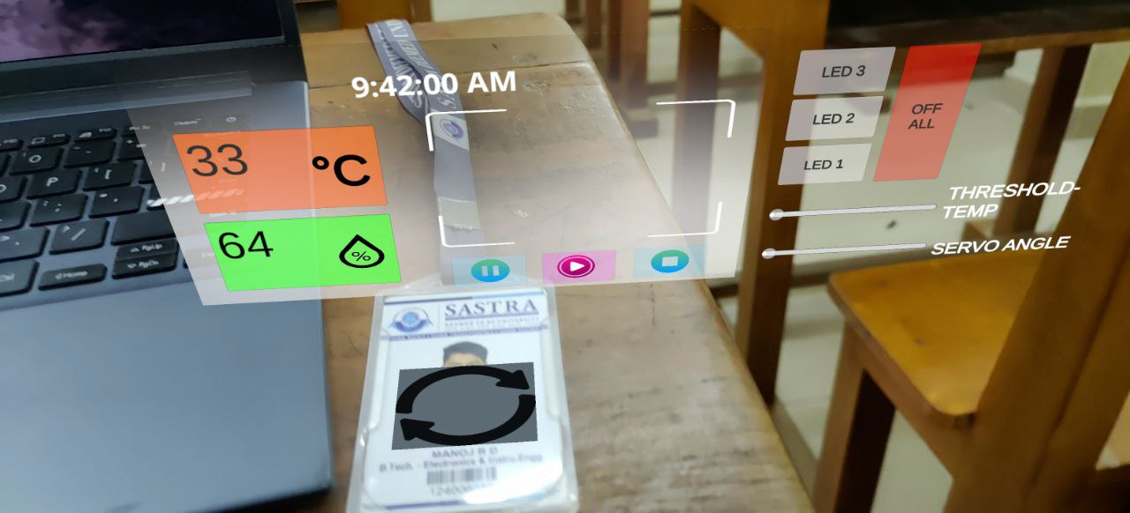
OUTPUT:

Slide 11
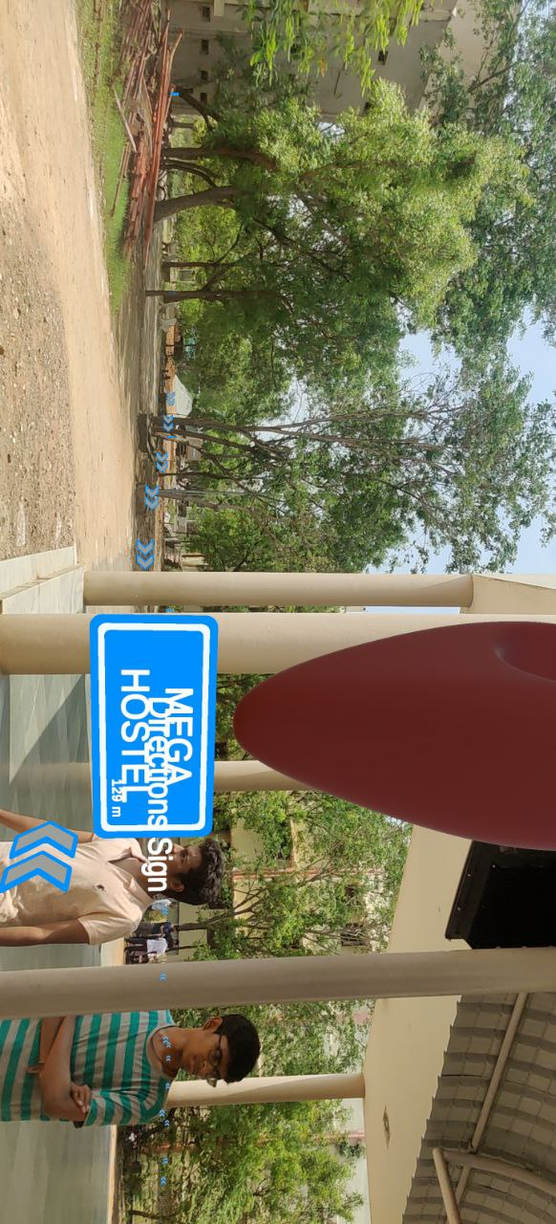
OUTPUT:

Slide 12
REFERENCE:
https://www.researchgate.net/publication/320704050_AUGMENTED_REALITY_IN_MOBILE_DEVICES
Augmented Reality – Layar Reality Browser [online] Available: http://www.layar.com/.
https://www.researchgate.net/publication/342383348_Augmented_Reality_Navigation

